Slide 1
Optical Character Recognition
Group 4
Chen, Xinyi (xc2464)
Liao Ziyi (zl2739)
Liu, Sitong (sl4460)
Wu, Weixuan (ww2493)
Xiao, Caihui (cx2225)

Slide 2
Outline
Task
Text Detection (Refer to D3: Recognizing Garbage in OCR Output on Historical Documents)
Text Correction (Refer to C5: Context – Sensitive Error Correction: Using Topic Models to Improve OCR)
Summary
Performance Measurement

Slide 3
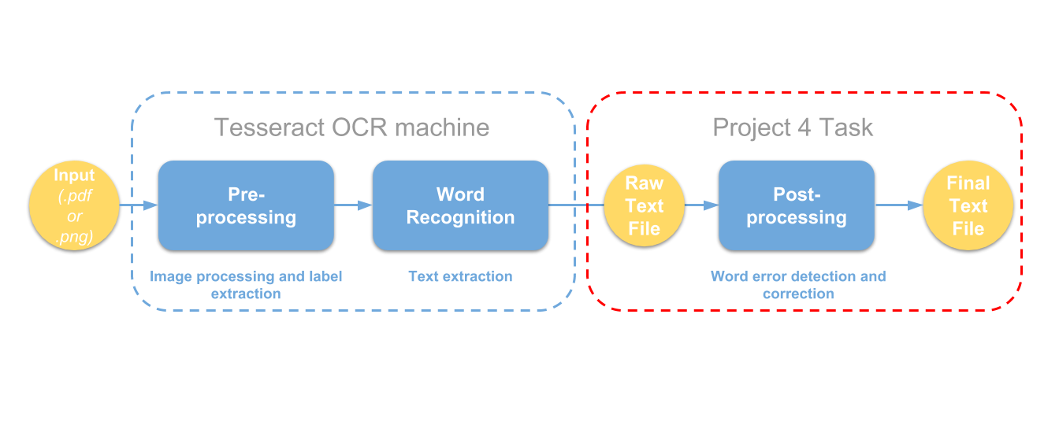
Task

Slide 4
Task
Implement and evaluate an algorithm for OCR post-processing to enhance Tesseract OCR output
Text Detection: Support Vector Machines (SVM) model
Text Correction: Latent Dirichlet Allocation (LDA)topic model

Slide 5
Text Detection SVM (Support Vector Machines) Model （C=1， Kernel=‘rbf’）
Definition
Binary problem (classification problem)
Feature extraction
Dataset

Slide 6

SVM-Features Extraction
Features extraction:
length of string, number of vowels and consonants, number of special symbols, number of digits and quotients, number of lower and upper case letters, consecutive same symbol, consecutive consonants; most frequent symbol; non-alphabetical symbols;
Bigram – for each bigram we checked if it occurs in the list LB and we looked at the frequency value. We derived a value for the total naturalness of bigram in the string‘
Levenshtein distance (most complex features) : measure the plausibility of finding a simple correction of the input string to a ‘pausible historical word’

Slide 7
Evaluation – SVM model
Accuracy : 0.911
Precision: 0.966
Recall: 0.811

Slide 8
Text Correction – Latent Dirichlet Allocation (LDA) Model
Probabilities of different topic mixtures

Slide 9
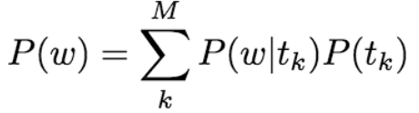
Topic model:
W is a word,
M is the number of topics in the model
tk is a topic
P(tk): applying the trained topic model to correctly recognizing words in the document

Slide 10
Summary
Tesseract OCR
Detected Errors
Undetected Errors
Correctable Words
Uncorrectable Words
Capital
2. Punctuation
3. Numbers
Correctly Corrected words
Incorrectly Corrected words
Fail to do the correction

Slide 11
Performance
 | Tesseract | Tesseract_with_postprocessing
Word_wise_recall | 0.6025360 | 0.9498475
Word_wise_precision | 0.4267980 | 0.9413974
Character_wise_recall | 0.8773070 | 0.9573690
Character_wise_precision | 06178603 | 0.9655928

Slide 12
Next Step
Hierarchical LDA (Relationship of each topic)

Slide 13
Reference Paper
D3: Recognizing Garbage in OCR Output on Historical Documents
C5: Context – Sensitive Error Correction: Using Topic Models to Improve OCR

Slide 14
Acknowledge
Special thanks for Professor Ying Liu and Chengliang Tang for hosting lectures and providing datasets.

Slide 15
Q & A

Slide 16
THANK YOU!

